Slide 1
Theory of Computation
Vaibhav Narayan Chunekar
K. J. Somaiya College of Engineering

Slide 2
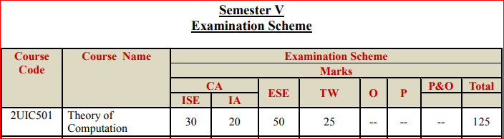

Slide 3
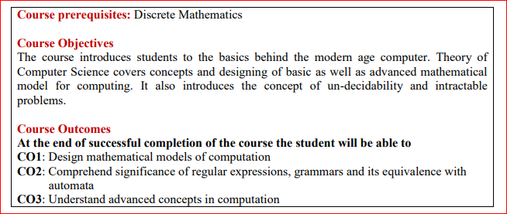

Slide 4
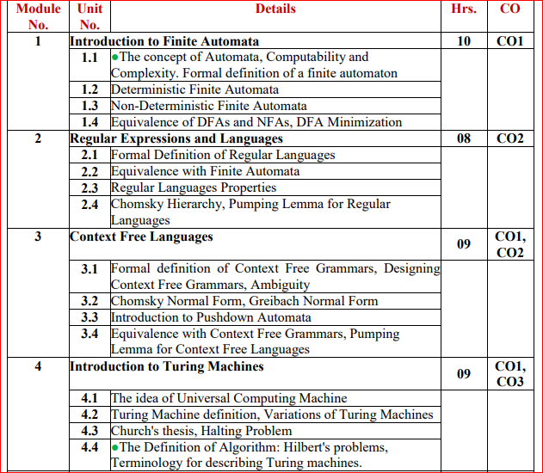

Slide 5
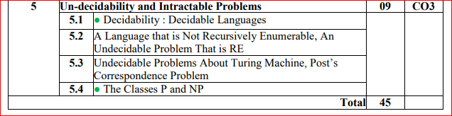
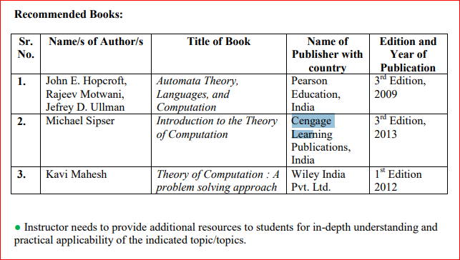

Slide 6
Introduction to Finite Automata
What is Computation?
Multiplication of numbers
Finding Word in a dictionary
Checking whether there is path between two vertices or not?

Slide 7
Computational Devices
Examples
Calculator
Cell Phone/ Smart Phone
Computer
Pen/Paper (standard)
Study Computational Devices
Resources Devices used (Memory /Processors etc)
Power and Limitation

Slide 8
Kinds of Computation Devices
Finite Automata: Finite memory, Number of state.
Automaton: Plural form of automata

Slide 9
Example of Finite Automata
Electric Switch: ON/OFF
1 .push
1.push
ODD/EVEN
EXAMPLE:
11 → STATE→OFF 111→ ? 1111→?
ON
OFF
ON
OFF

Slide 10
Example of Finite Automata
2. Electric Fan Regulator
Mode: 1) OFF
2) Low
3) Medium
4) High
Turn: Clockwise/Anticlockwise
CCACC➔STATE ?
AACCCC→STATE?
1
1
1
1
1
1
0
0
0
0
2
0
2
0
2
2
2
3
3
3
3
3

Slide 11
Example 3: String
L={ X| X is binary String Divisible by 4}
L= The string ends with Two Zeroes are divisible by 4
Note: Observe that the set of binary number divisible by 4 are exactly that have suffix as 00
Binary | Dec | Decision
100 | 4 | yes
110 | 6 | no
1100 | 12 | yes

Slide 12
Design Finite Automata for Divisible by 4
STATE: ACCEPT/REJECT
➔ Use binary 0/1
01
00
11
10

Slide 13
Check String Accepted by machine 110 ,1100?

Slide 14
Thanks… Any Question???

